Slide 1
Fundamentals of Real-Time Systems
Outline
Concepts and misconceptions
Multidisciplinary design challenges
Birth and evolution of real-time systems
Discussion

Slide 2
Definition: System
A system is a mapping of a set of inputs into a set of outputs
A system is an assembly of components connected together in an organized way
A system is fundamentally altered if a component joins or leaves it
It has a purpose
It has a degree of permanence
It has been defined as being of particular interest

Slide 3
Example: A Real-Time Control System
Inputs are excitations and outputs are corresponding responses
Inputs and outputs may be digital or analog
Inputs are associated with sensors, cameras, etc.
Outputs with actuators, displays, etc.

Slide 4
Definition: Response Time
The time between the presentation of a set of inputs to a system and the realization of the required behavior, including the availability of all associated outputs, is called the response time of the system
How fast and punctual does it need to be?
Depends on the specific real-time system
But what is a real-time system?

Slide 5
Definitions: Real-Time System
A real-time system is a computer system that must satisfy bounded response-time constraints or risk severe consequences, including failure
A real-time system is one whose logical correctness is based on both the correctness of the outputs and their timeliness

Slide 6
Definition: Failed System
A failed system is a system that cannot satisfy one or more of the requirements stipulated in the system requirements specification
Hence, rigorous specification of the system operating criteria, including timing constraints, is necessary

Slide 7
Soft, Hard, and Firm “Real-Time”
Definition: Soft Real-Time System
A soft real-time system is one in which performance is degraded but not destroyed by failure to meet response-time constraints
Definition: Hard Real-Time System
A hard real-time system is one in which failure to meet even a single deadline may lead to complete or catastrophic system failure
Definition: Firm Real-Time System
A firm real-time system is one in which a few missed deadlines will not lead to total failure, but missing more than a few may lead to complete or catastrophic system failure

Slide 8
Example: Real-Time Classification
System | Real-Time Classification | Explanation
Avionics weapons delivery system in which pressing a button launches an air-to-air missile | Hard | Missing the deadline to launch the missile within a specified time after pressing the button may cause the target to be missed, which will result in a catastrophe
Navigation controller for an autonomous weed-killer robot | Firm | Missing a few navigation deadlines causes the robot to veer out from a planned path and damage some crops
Console hockey game | Soft | Missing even several deadlines will only degrade performance

Slide 9
Definitions: Event and Release Time
Definition: Event
Any occurrence that causes the program counter to change non-sequentially is considered a change of flow-of-control, and thus an event
Definition: Release Time
The release time is the time at which an instance of a scheduled task is ready to run, and is generally associated with an interrupt

Slide 10
Taxonomy of Events
An event can be either synchronous or asynchronous
Synchronous events are those that occur at predictable times in the flow-of-control
Asynchronous events occur at unpredictable points in the flow-of-control and are usually caused by external sources
Moreover, events can be periodic, aperiodic or sporadic
A real-time clock that pulses regularly is a periodic event
Events that do not occur at regular periods are called aperiodic
Aperiodic events that tend to occur very infrequently are called sporadic

Slide 11
Example: Various Types of Events
Type | Periodic | Aperiodic | Sporadic
Synchronous | Cyclic code | Conditional branch | Divide-by-zero (trap) interrupt
Asynchronous | Clock interrupt | Regular, but not fixed-period interrupt | Power-loss alarm

Slide 12
Deterministic Systems
For any physical system, certain states exist under which the system is considered to be out of control
The software controlling such a system must therefore avoid these states
In embedded real-time systems, maintaining overall control is extremely important
Software control of any real-time system and associated hardware is maintained when the next state of the system, given the current state and a set of inputs, is predictable
Definition: Deterministic System
A system is deterministic, if for each possible state and each set of inputs, a unique set of outputs and next state of the system can be determined

Slide 13
CPU Utilization or Time-Loading Factor
The final term to be defined is a critical measure of real-time system performance
Because the CPU continues to execute instructions as long as power is applied, it will more or less frequently execute instructions that are not related to the fulfillment of a specific deadline
The measure of the relative time spent doing non-idle processing indicates how much real-time processing is occurring
Definition: CPU Utilization Factor
The CPU utilization or time-loading factor, U, is a relative measure of the non-idle processing taking place

Slide 14
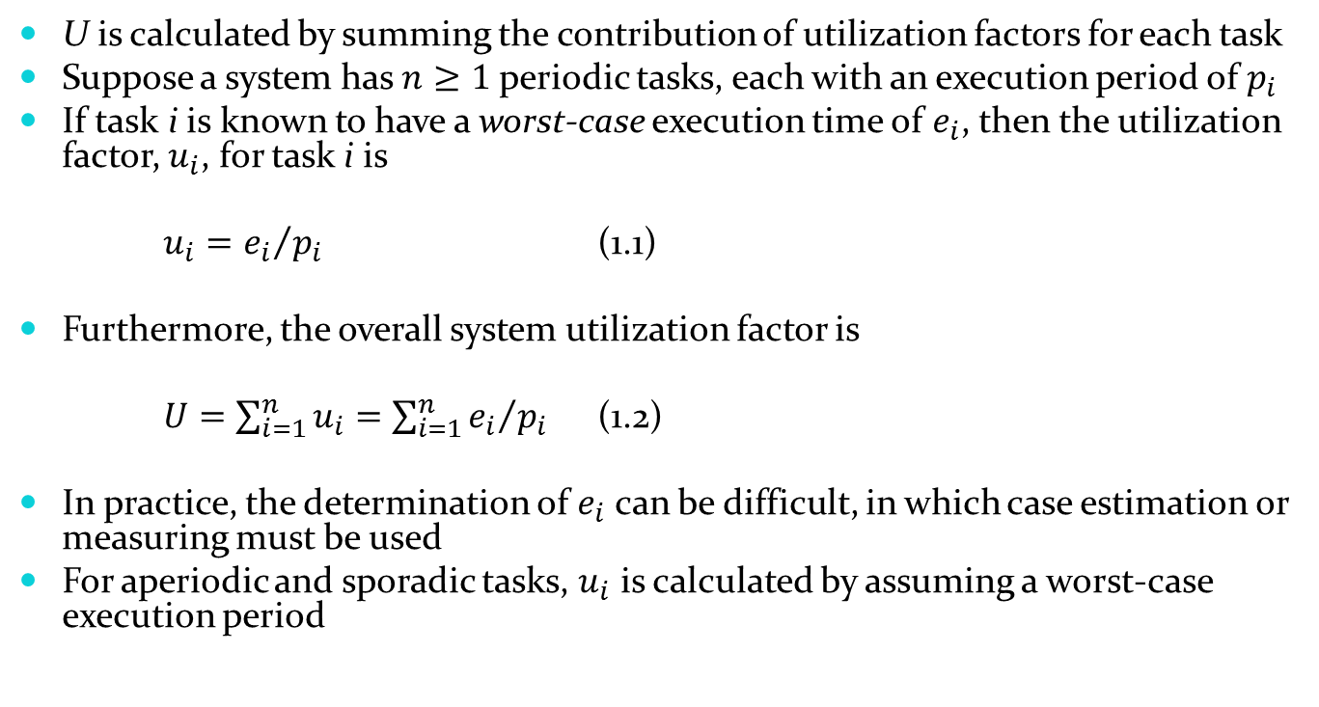
Calculation of U
U is calculated by summing the contribution of utilization factors for each task
Suppose a system has $n≥1$ periodic tasks, each with an execution period of $p_{i}$
If task i is known to have a worst-case execution time of $e_{i}$, then the utilization factor, $u_{i}$, for task i is
$u_{i}={e_{i}}/{p_{i}}$ (1.1)
Furthermore, the overall system utilization factor is
$U=\sum_{i=1}^{n}{u_{i}=\sum_{i=1}^{n}{{e_{i}}/{p_{i}}}}$ (1.2)
In practice, the determination of $e_{i}$ can be difficult, in which case estimation or measuring must be used
For aperiodic and sporadic tasks, $u_{i}$ is calculated by assuming a worst-case execution period

Slide 15
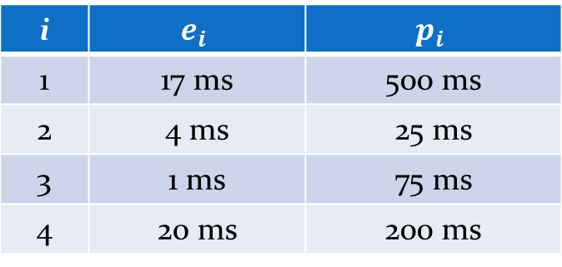
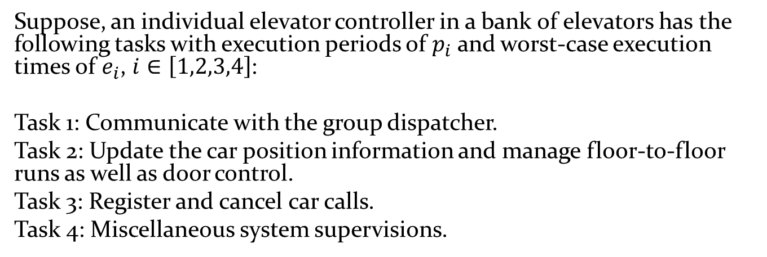
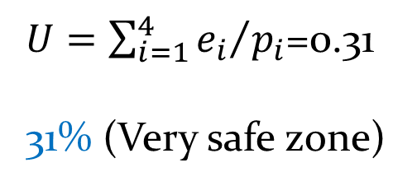
Example: Calculation of U
Suppose, an individual elevator controller in a bank of elevators has the following tasks with execution periods of $p_{i}$ and worst-case execution times of $e_{i}$, $i∈\left[1,2,3,4\right]$:
Task 1: Communicate with the group dispatcher.
Task 2: Update the car position information and manage floor-to-floor runs as well as door control.
Task 3: Register and cancel car calls.
Task 4: Miscellaneous system supervisions.
i | $$e_{i}$$ | $$p_{i}$$
1 | 17 ms | 500 ms
2 | 4 ms | 25 ms
3 | 1 ms | 75 ms
4 | 20 ms | 200 ms
$U=\sum_{i=1}^{4}{{e_{i}}/{p_{i}}}$=0.31
31% (Very safe zone)

Slide 16
Rich Variety of “Real-Time” Disciplines

Slide 17
Influencing Disciplines
The selection of hardware and system software, and evaluation of the trade-off needed for a competitive solution
Specification and design of real-time systems, as well as correct and inclusive representation of temporal behavior
Understanding the nuances of programming language(s) and the real-time implications resulting from their compilation
Optimizing (with application-specific objectives) of system fault tolerance and reliability through careful design and analysis
The design and administration of adequate tests, and the selection of appropriate development tools and test equipment
Taking full advantage of open systems technology and interoperability
Estimating and measuring response times and (if needed) reducing them; performing a schedulability analysis

Slide 18
Diversifying Applications
The history of real-time systems is tied inherently to the evolution of computer
Modern real-time systems, such as those that control nuclear power plants, are highly sophisticated
Nevertheless, they may still exhibit characteristics of those pioneering systems developed in the 1940s – 1960s
An excellent example of an advanced real-time system is the Mars Exploration Rover of NASA
An autonomous system with extreme reliability requirements
Receives commands and sends measurement data over radio-communications links
Performs its scientific missions with the aid of multiple sensors, processors, and actuators

Slide 19
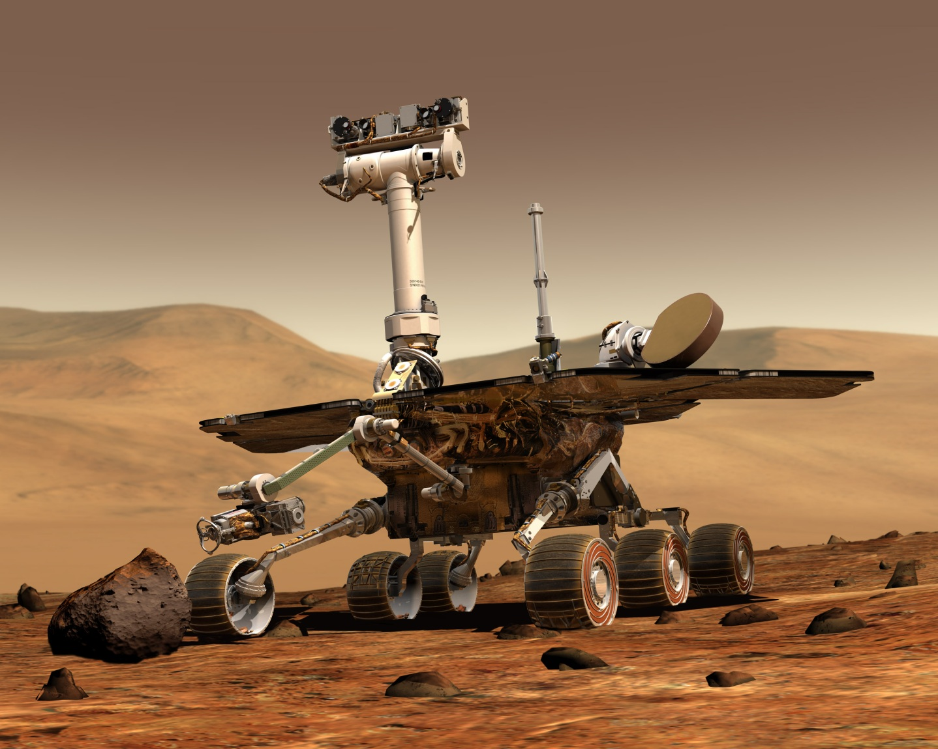
Mars Exploration Rover of NASA

Slide 20
Practical Embedded Systems
Aerospace
Flight control
Navigation
Pilot interface
Automotive
Airbag deployment
Antilock braking
Fuel injection
Household
Microwave oven
Rice cooker
Washing machine
Industrial
Crane
Paper machine
Welding robot
Multimedia
Console game
Home theater
Simulator
Medical
Intensive care monitor
Magnetic resonance imaging
Remote surgery

Slide 21
Selected Advancements behind Modern Real-Time Systems
Aspects of operations research, i.e., scheduling theory (late 1940s)
Queuing theory (early 1950s)
IBM’s Basic Executive with diverse real-time scheduling (1962)
Liu’s and Layland’s seminal work on rate-monotonic theory (1973)
Introduction of the first microprocessors (1970s)
First real-time operating systems for microprocessors (1970s – 1980s)
Theoretical work on improving predictability and reliability of real-time systems (1980s – 1990s)
Contributions on solving problems related to multitasking systems (1980s – 1990s)
Advancements in hardware, viable open-source software, powerful commercial design and implementation tools, and expanded programming language support (2000s)

Slide 22
Discussion
In the coming chapters, we will cover a broad range of vital themes for practicing engineers
While the emphasis is on software issues, the fundamentals of real-time hardware are carefully outlined, as well

Slide 23
Task characteristics of a real workload
A simple task model has the following simplifying assumptions:
All tasks in the task set are strictly periodic.
The relative deadline of a task is equal to its period/frame.
All tasks are independent; there are no precedence constraints.
No task has any non-preemptible section, and the cost of preemption is negligible.
Only processing requirements are significant; memory, and I/O requirements are negligible.
For real-time systems, it is of utmost importance that the scheduling algorithm produces a predictable schedule
Many real-time operating systems use round-robin scheduling policy because it is simple and predictable.

Slide 24
Round-robin scheduling
In a round-robin system several processes are executed sequentially to completion, often in conjunction with a cyclic executive.
In round-robin systems with time slicing, each executable task is assigned a fixed-time quantum called a time slice in which to execute.
A fixed-rate clock is used to initiate an interrupt at a rate corresponding to the time slice.
The task executes until it completes or its execution time expires, as indicated by the clock interrupt.
If the task does not execute to completion, its context must be saved. The task is the placed at the end of the executable list. The context of the next executable task in the list is restored, and it resumes execution.
Round-robin systems can be combined with pre-emptive priority systems, yielding a kind of mixed system.

Slide 25
Round-robin scheduling
Mixed scheduling of three tasks. Here process A and C are of the same priority, whereas B is of higher priority. Process A is executing for some time when it is preempted by task B, which executes until completion. When process A resumes, it continues until its time slice expires, at which time context is switched to process C, which begins executing.

Slide 26
Cyclic executives
A simple approach that generates a complete and highly predictable schedule.
The CE refers to a scheduler that deterministically interleaves and sequentializes the execution of periodic tasks on a processor according to a pre-run-time schedule.
In general terms, the CE is a table of procedure calls, where each task is a procedure, and it executes a single do loop.
Scheduling decisions are made periodically, rather than at arbitrary times.
Time intervals during scheduling decision points are referred to as frames or minor cycles, and every frame has a length f called the frame size.

Slide 27
Cyclic executives
The major cycle is the minimum time required to execute tasks allocated to the processor ensuring the deadlines and periods of all processes are met.
The major cycle or the hyperperiod is equal to the least common multiple of the periods, i.e., lcm(p₁, … p_{n}).
As scheduling decisions are made only at the beginning of every frame, there is no preemption within each frame.
The phase of each periodic task is a nonnegative integer multiple of the frame size.
The scheduler carries out monitoring and enforcement actions at the beginning of each frame.

Slide 28
Cyclic executives

Slide 29
Cyclic executives

Slide 30
Rate-monotonic scheduling
Theorem (Rate-monotonic) [Liu and Layland ‘73]
Given a set of periodic tasks and preemptive priority scheduling, then by assigning priorities such that the tasks with shorter periods have higher priorities (rate monotonic) yields an optimal scheduling algorithm.
See book for sketch of proofs

Slide 31
Rate-monotonic scheduling

Slide 32
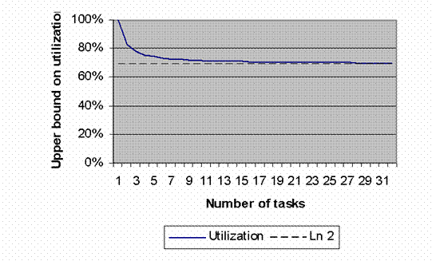
Rate-monotonic scheduling
Upper bound on utilization in a rate-monotonic system as a function of the number of tasks. Notice how it rapidly converges to 0.69.

Slide 33
Rate-monotonic scheduling
Not every system is appropriate as rate-monotonic.
Consider nuclear plant control system – should visual display have highest priority?
What about aperiodic and sporadic tasks?
In these cases RM used a feasibility check.

Slide 34
Earliest deadline first
In contrast to fixed-priority algorithms, in dynamic priority schemes the priority of the task with respect to that of the other tasks changes as tasks are released and completed.
One of the most well-known dynamic algorithm, earliest-deadline-first (EDF), deals with deadlines rather than execution times.
The ready task with the earliest deadline has the highest priority at any point of time.

Slide 35
Earliest deadline first

Slide 36
EDF example
Task set

